Slide 1

Trees Get Degrees: Using Decision Trees to Determine Important Features for College Acceptance
By Weston Grewe and Angela Morrison

Slide 2


Motivation
Tailored to specific school communities
Better informing schools on how to prepare students to get into college
Interpretable and practical decision tree results

Slide 3

The Data
2017 Public School Data from Massachusetts
Remove schools that do not cater to any high school students
Remove features that are not standard among most if not all schools in the country
Convert data to binary variables for LP
Average Percentage of Students that Attended College after high school in Massachusetts
Used in determining is a school is “successful” in that they send a higher percentage of students to college after high school than the state as a whole

Slide 4

Quick Example
Name | Cool | Tall | Strong Bitmoji Game | Eats Pineapple on Pizza
Alyssa | 1 | 0 | 1 | 1
Angela | 0 | 0 | 1 | -1
Collin | 1 | 1 | 0 | 1
Drew | 1 | 1 | 1 | 1
Michael | 1 | 1 | 0 | 1
Sandy | 1 | 1 | 0 | 1
Rebecca | 1 | 1 | 1 | 1
Weston | 1 | 0 | 1 | 1
Steffen | 1 | 1 | 0 | 1
Split on Cool
Angela
The Rest of y’all

Slide 5


The Model
Maximizing the correct classification such that we still have a proper decision tree
Want to make as many samples as possible are sorted into correct bins
Tree should stay relatively small to keep interpretability

Slide 6

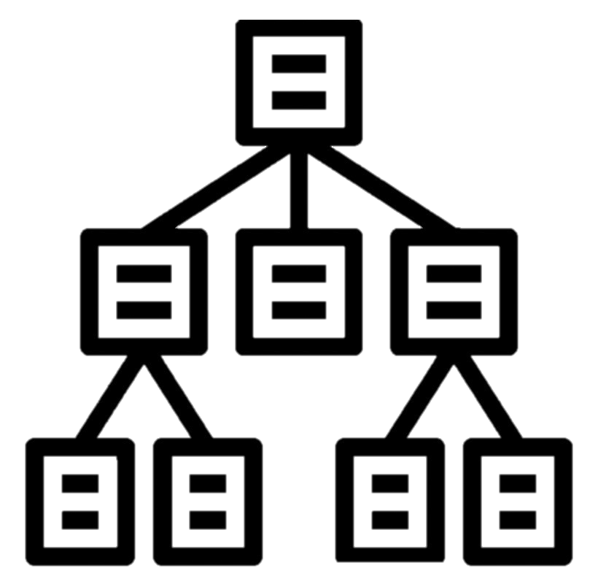
Model Set Up
Separate samples into “positive” and “negative” outcomes
Define tree structure
Determine ratio between total number of “positive” and “negative” outcomes to include factor in objective function

Slide 7


Why an IP?
LP is not realistic
Allows for uninterpretable splitting of variables (especially since they are categorical/binary)

Slide 8


Objective
Determine the optimal decision tree
Get information on the main features a school should focus on adjusting or improving
Test varying tree structures and compare important features determined for reach structure
Use this to implement policy changes
Ex: If the number of SAT test takes is an important feature, then the school could possibly implement chances for students to take SAT prep or offer more chances for student to take the SAT on campus

Slide 9


Project Plans
Define a set of tree structures for testing
Test varying sets of features on said tree structures
Determine list of adjustable features and recommend policy changes

Slide 10
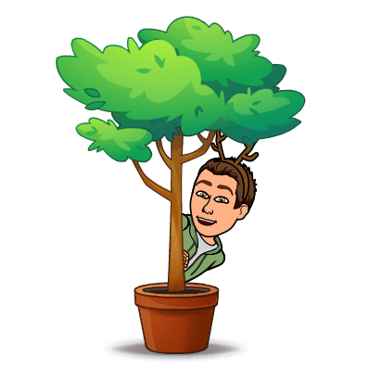

Questions, comments, concerns?

